Slide 1
Price Prediction in Bangalore's Housing Market Using Ensemble Models A Data-Driven Approach
Presented by: Vidhaan Appaji Ankur Bhagat Antareep Chakraborty
Course: AAI-501 – Introduction to Artificial Intelligence Instructor: Mr. Ankur Bist University: University of San Diego

Slide 2
Introduction
Bangalore’s real estate market is experiencing rapid growth, driven largely by the IT and infrastructure boom.
Accurately predicting housing prices in such a dynamic market is essential for buyers, investors, and developers.
This project uses machine learning techniques—specifically ensemble models—to build predictive tools that estimate property prices.
The models take into account various features such as square footage, number of rooms, amenities, and location.
Three models were tested and compared: Decision Tree, Random Forest, and XGBoost Regressor.

Slide 3

Data Preprocessing
The dataset was sourced from Kaggle's Bengaluru housing data repository.
Preprocessing steps included:
Removing missing values and outliers that could distort model predictions.
Encoding categorical variables like 'location' using one-hot or label encoding.
Scaling numerical variables to bring them to a common range.
These steps ensured a clean, consistent dataset suitable for training machine learning models.
The target variable for prediction was ‘price’.

Slide 4
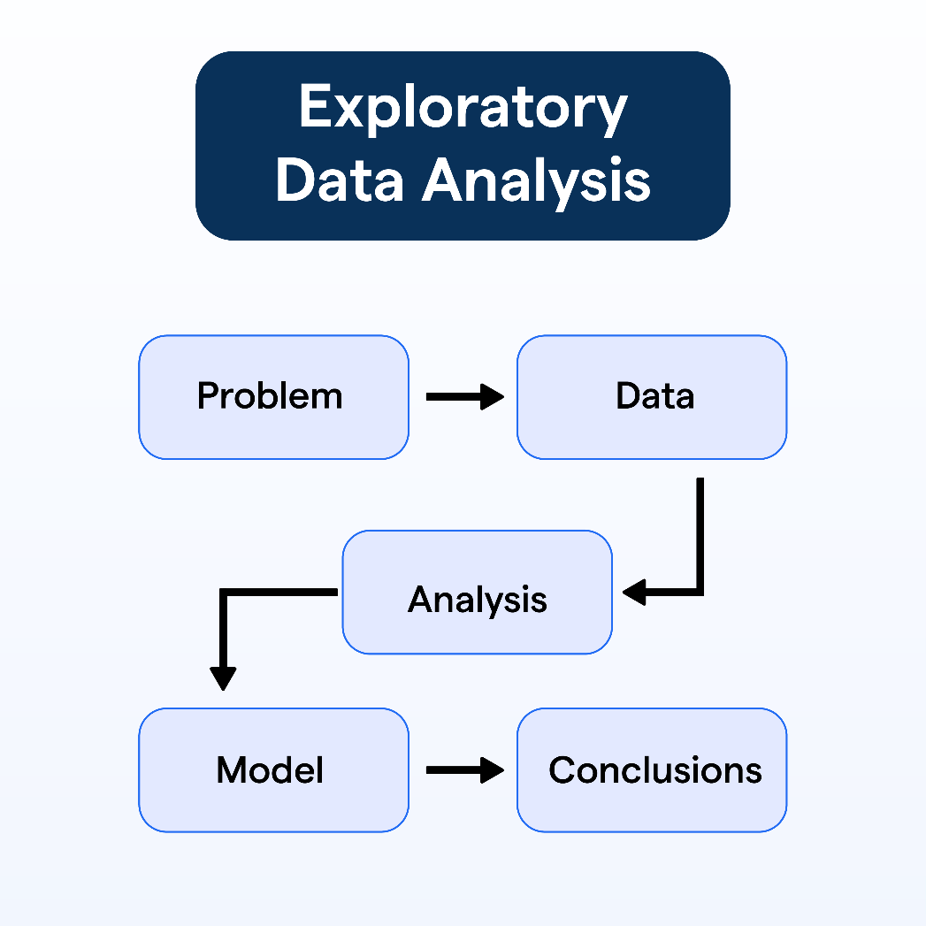
Exploratory Data Analysis (EDA)
EDA helped us understand relationships and patterns in the data.
Strong correlation observed between total square footage and price, confirming its importance.
Location played a critical role: high-end localities consistently showed higher prices.
Non-linear effects were noticed for BHKs and bathrooms—after a certain point, more rooms or bathrooms didn’t translate to higher prices.
Insights from EDA guided feature selection and model expectations.

Slide 5
Model Selection
We used three supervised regression models to compare performance:
Decision Tree Regressor: Easy to interpret but prone to overfitting.
Random Forest Regressor: Uses bagging to reduce overfitting and improve generalization.
XGBoost Regressor: Uses boosting to iteratively correct errors and improve predictions.
Each model was tested with both default parameters and optimized hyperparameters for comparison.

Slide 6
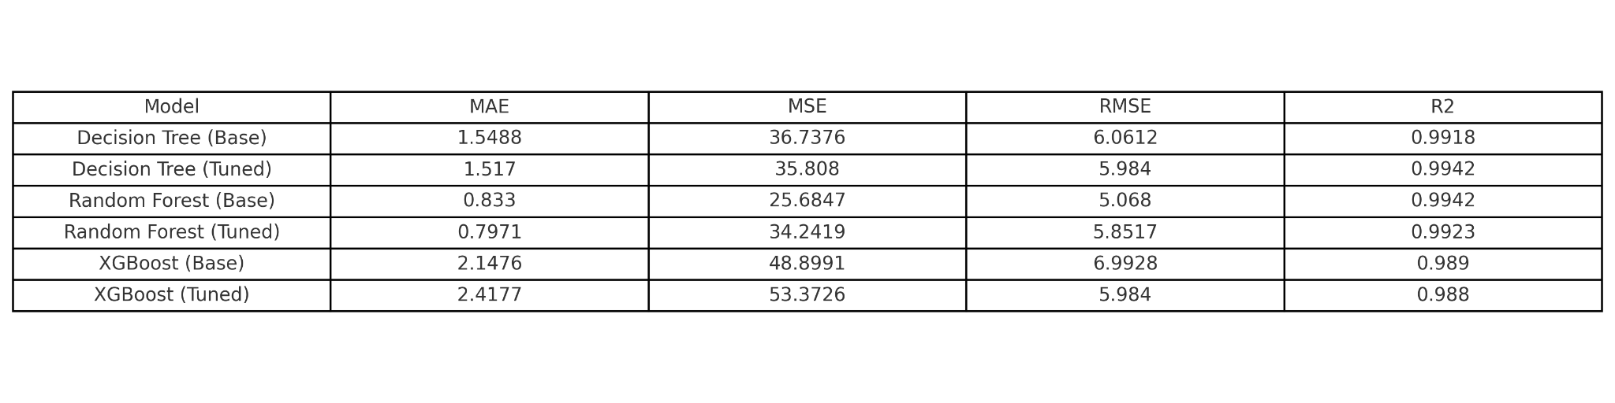
Evaluation Metrics
Four standard regression metrics were used to evaluate the models:
Mean Absolute Error (MAE): Average size of errors, easy to interpret.
Mean Squared Error (MSE): Penalizes larger errors more heavily.
Root Mean Squared Error (RMSE): Same units as the predicted price, making interpretation easier.
R² Score: Measures how much of the price variation is explained by the model (closer to 1 is better).
Fig: Performance metrics of Baseline Models and Fine Tuned Models

Slide 7
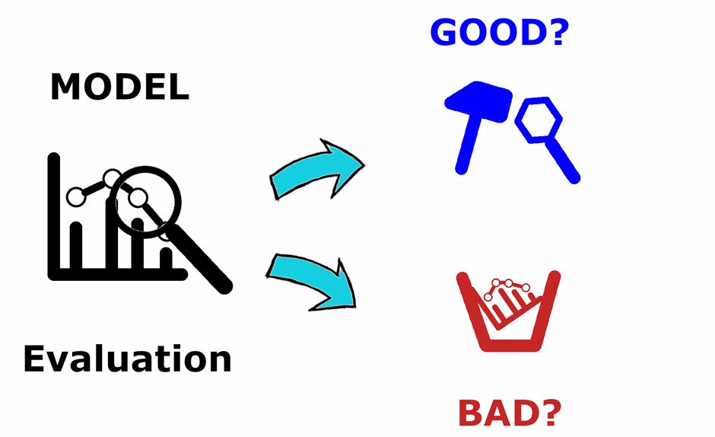
Model Performance
Decision Tree (Tuned):
MAE: 1.52 | RMSE: 5.98 | R² Score: 0.9942
Good fit, but slightly higher error metrics compared to ensemble models.
Random Forest (Tuned):
MAE: 0.80 | RMSE: 5.85 | R² Score: 0.9923
Best overall performer, with consistent accuracy and minimal overfitting.
XGBoost (Tuned):
MAE: 2.42 | RMSE: 5.98 | R² Score: 0.9880
Underperformed possibly due to poor tuning or model instability with this dataset.

Slide 8
Feature Importance
The most influential features across models were:
Total square footage – directly correlated with property value.
Number of bathrooms – a proxy for property comfort and size.
Location – premium areas increased price significantly.
Secondary features like number of balconies and availability status also contributed meaningfully.
Feature importance plots confirmed these insights across all three models.

Slide 9
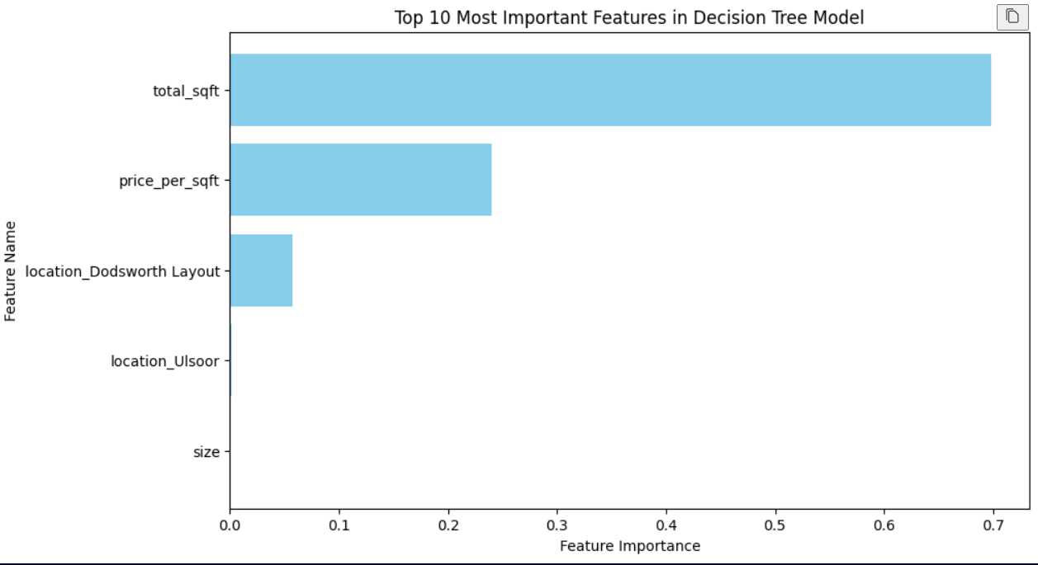
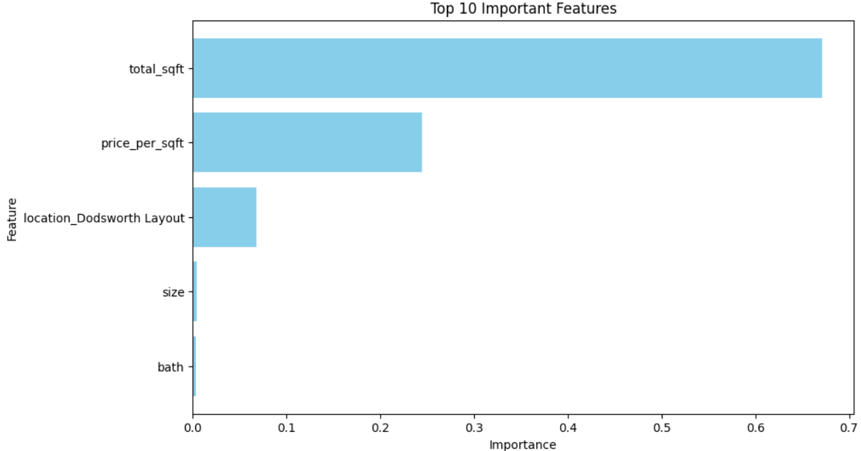
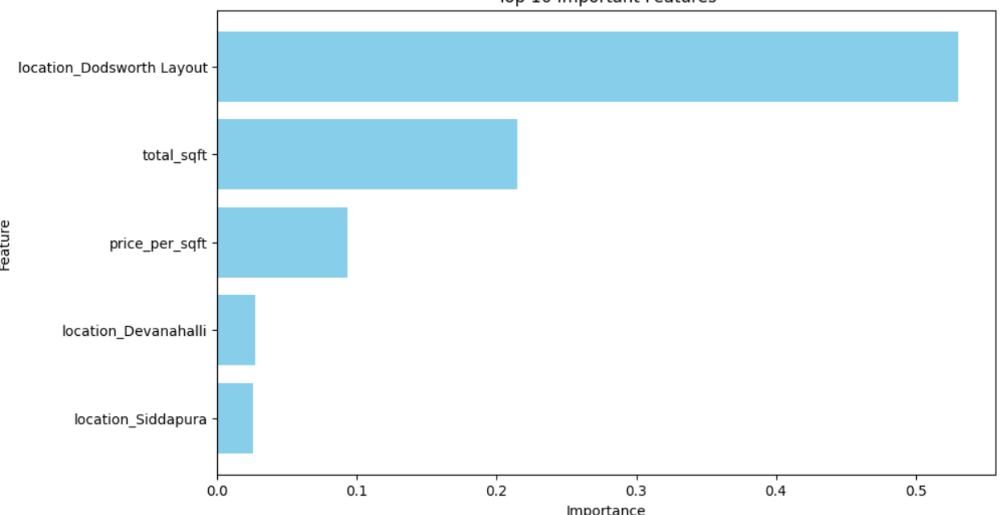
Feature Importance
Fig: Feature importances of Decision Tree Regressor
Fig: Feature importances of Random Forest Model
Fig: Feature importances of XGBoost Model

Slide 10
Conclusion
Random Forest Regressor emerged as the most effective model overall.
Decision Tree performed well and remained easy to interpret, but showed signs of overfitting.
XGBoost did not perform as expected in this context, likely due to overfitting or suboptimal tuning.
Proper feature selection and data preprocessing played a crucial role in achieving accurate predictions.
Ensemble models proved particularly effective for this kind of tabular regression problem.

Slide 11
References
Chen, T., & Guestrin, C. (2016). XGBoost: A scalable tree boosting system.
Breiman, L. (2001). Random Forests.
scikit-learn documentation – https://scikit-learn.org
XGBoost documentation – https://xgboost.readthedocs.io
Kaggle: Bengaluru House Price Data – https://www.kaggle.com/datasets/amitabhajoy/bengaluru-house-price-data

